Slide 1
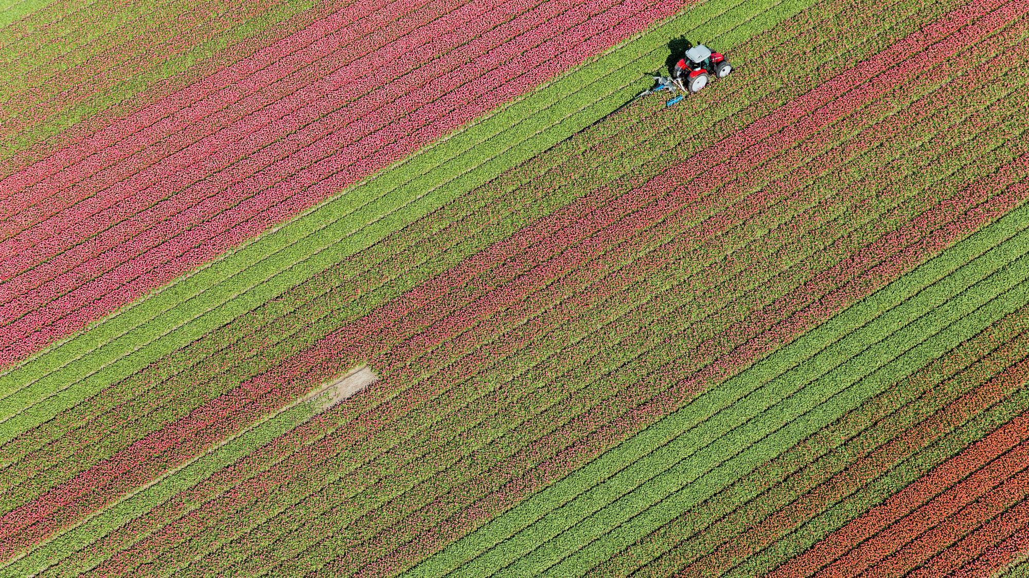

Agricultural Crop Yield Analysis Based on Productivity and Season
UNDER THE GUIDANCE OF: DONE BY :
MR.M.RAVINDRAN V.VIKRAM - 207R1A66J0
Asst.Prof G.BHEMESHWAR - 207R1A66E0
CSM A.ROHITH - 207R1A66C5

Slide 2


Contents
Abstract
Existing system
Proposed system
System Architecture
Class diagram
Sequence Diagram
Use Case Diagram
References

Slide 3
Abstract
India's primary industry is agriculture. Climate change has a negative effect on the majority of crops
Farmers are growing same crops repeatedly without trying new verity of crops and they are applying fertilizers in random quantity without knowing the deficient content and quantity.
A farmer's poor decision may have a significant negative impact on his family, his finances, and sometimes even his life. It also wastes a lot of land and productivity.
So, we have designed the system using machine learning algorithms for betterment of farmers
Hence by utilizing our system farmers can cultivate a new variety of crop, may increase in profit margin and can avoid soil pollution.

Slide 4

EXISTING SYSTEM
Crop Yield Prediction Models: Various models, including clustering methods like k-means and k-means++, have been used to predict crop yields. Data mining processes have also been employed for pesticide management in crop cultivation.
Soil Analysis: Soil type plays a crucial role in agriculture, and data mining techniques are applied to analyze soil parameters. Different soil varieties in India affect crop cultivation, and the importance of soil in enhancing crop growth is discussed.
Spatiotemporal Analysis: Spatiotemporal analysis models, like the SNN model, have been developed for crop estimation. Automatic systems that gather information about soil, weather conditions, and use clustering techniques to extract knowledge for farmers in crop cultivation have also been created.

Slide 5


PROPOSED SYSTEM
The Proposed system will give yield prediction and production prediction for particular land based on soil contents and weather parameters such as Temperature, Humidity, soil PH and Rainfall.
In this project ,We use historical data to analyze; such techniques are neural networks, K-nearest Neighbor.
The steps are Data Collection , Data Preprocessing , Machine Learning Algorithm For Crop and Rainfall Prediction (SVM , Decision Tree).
Alg0rithm’s used : Naïve Bayes , SVM , logistic Regression , Decision Tree , KNeighbrsClassifier.
Dataset taken from Kaggle , special focus on Logistic regression : accuracy – 80%.

Slide 6
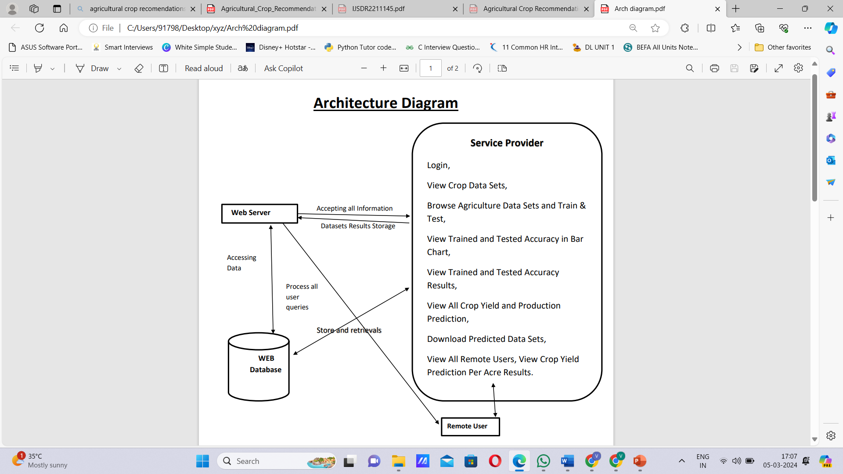
SYSTEM ARCHITECTURE

Slide 7
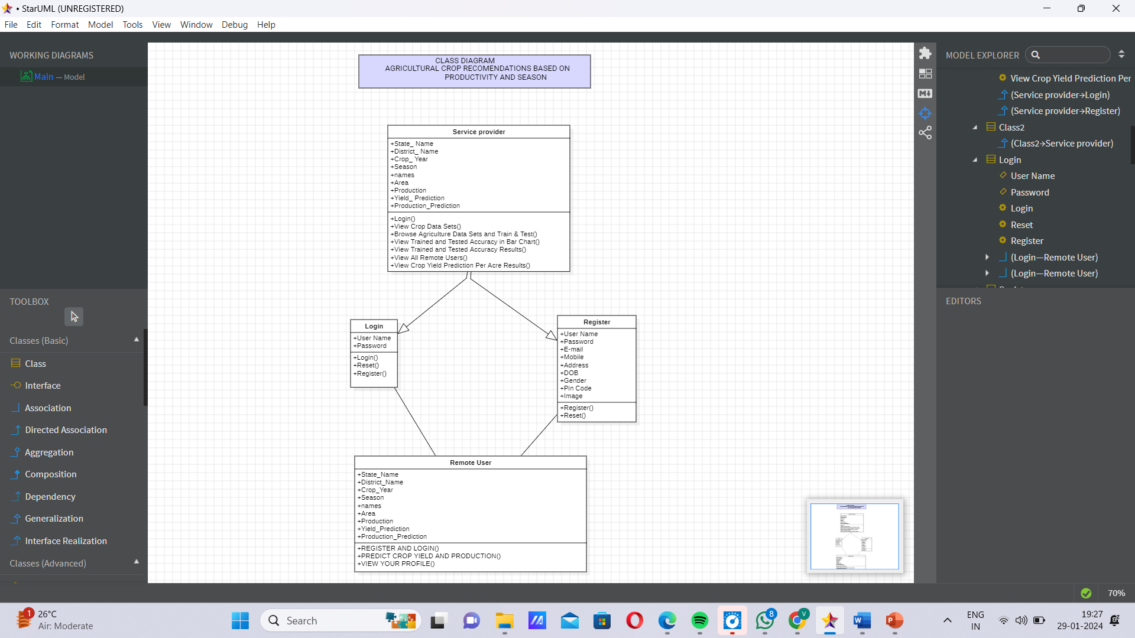
CLASS DIAGRAM

Slide 8
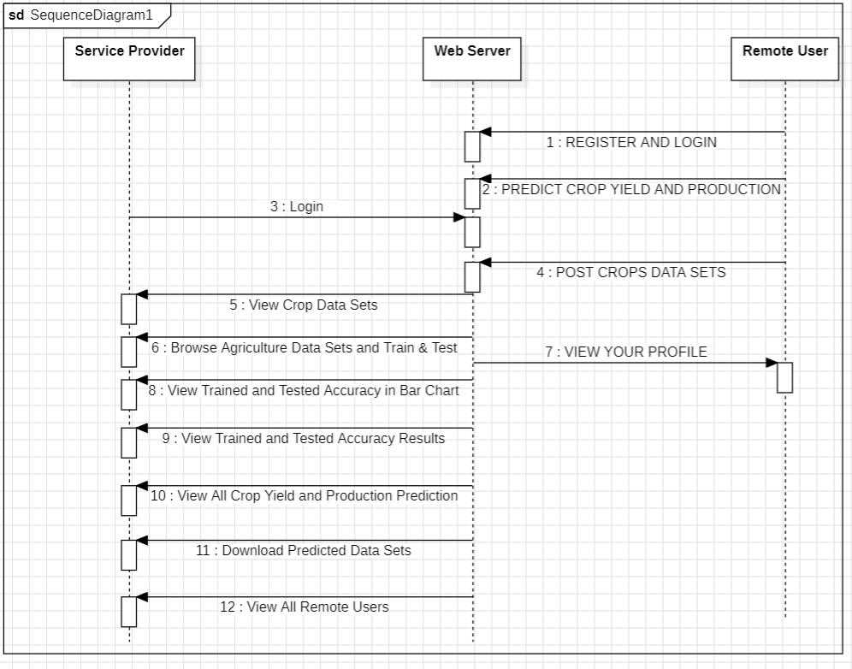

Slide 9
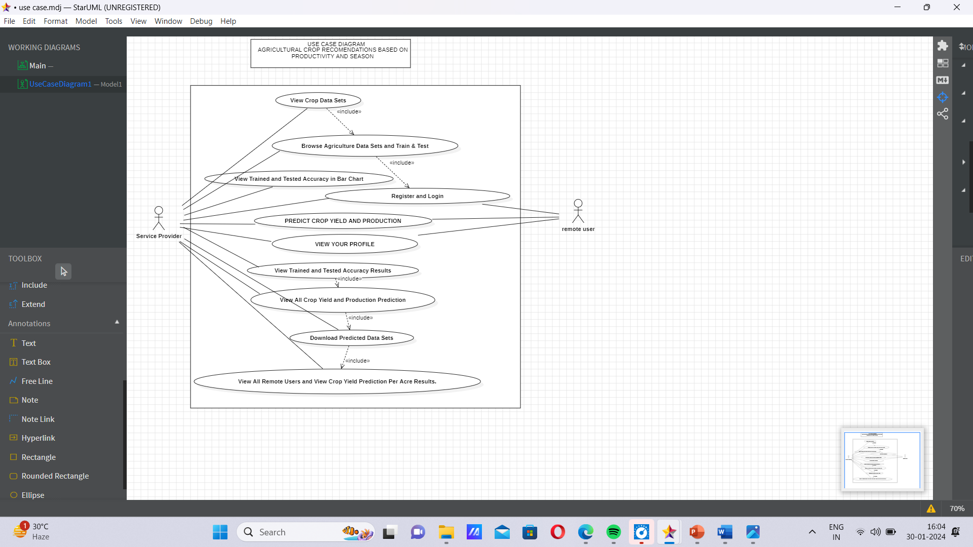

Slide 10
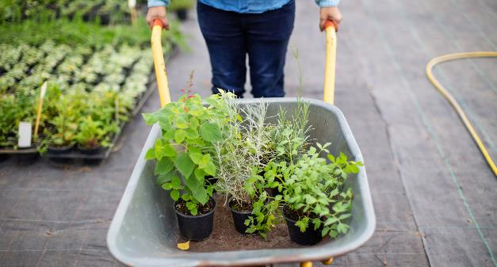
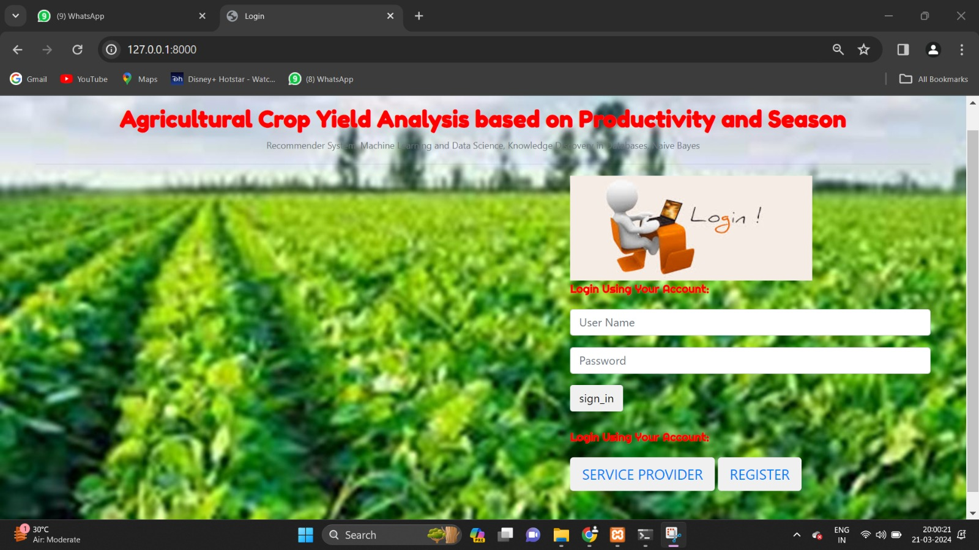
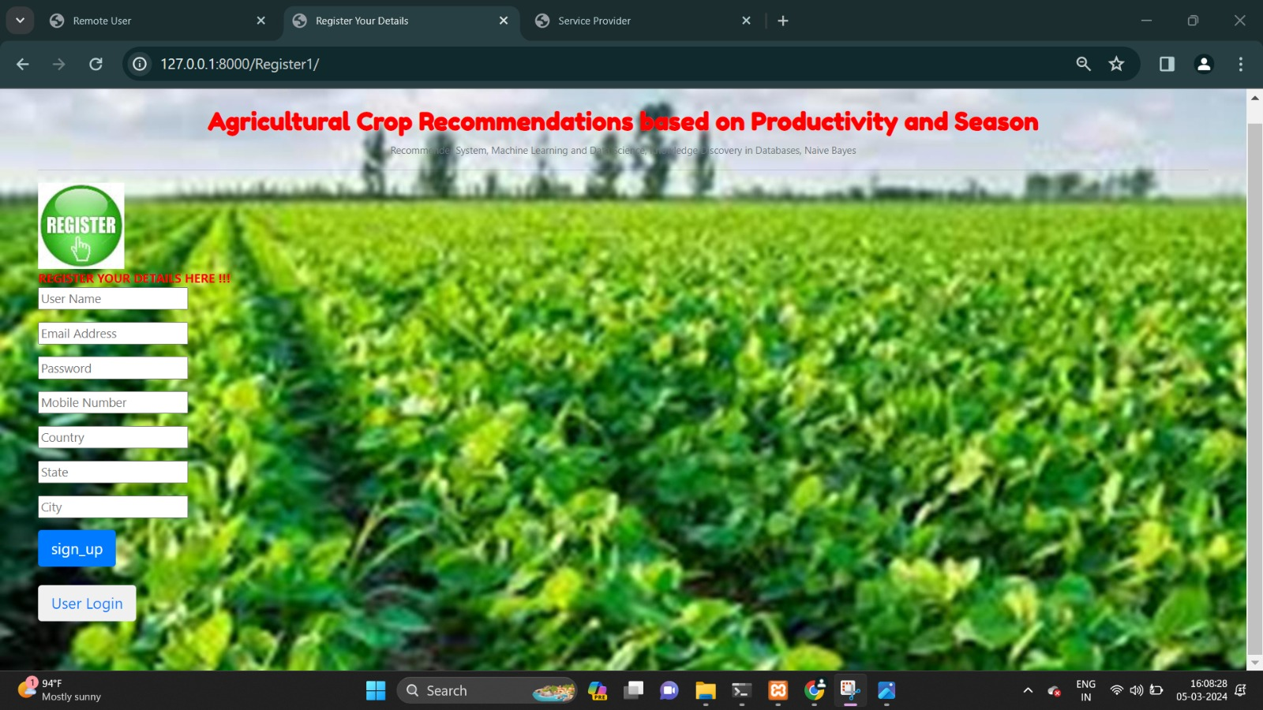
SCREENSHOTS
HOME PAGE
USER REGISTRATION PAGE

Slide 11
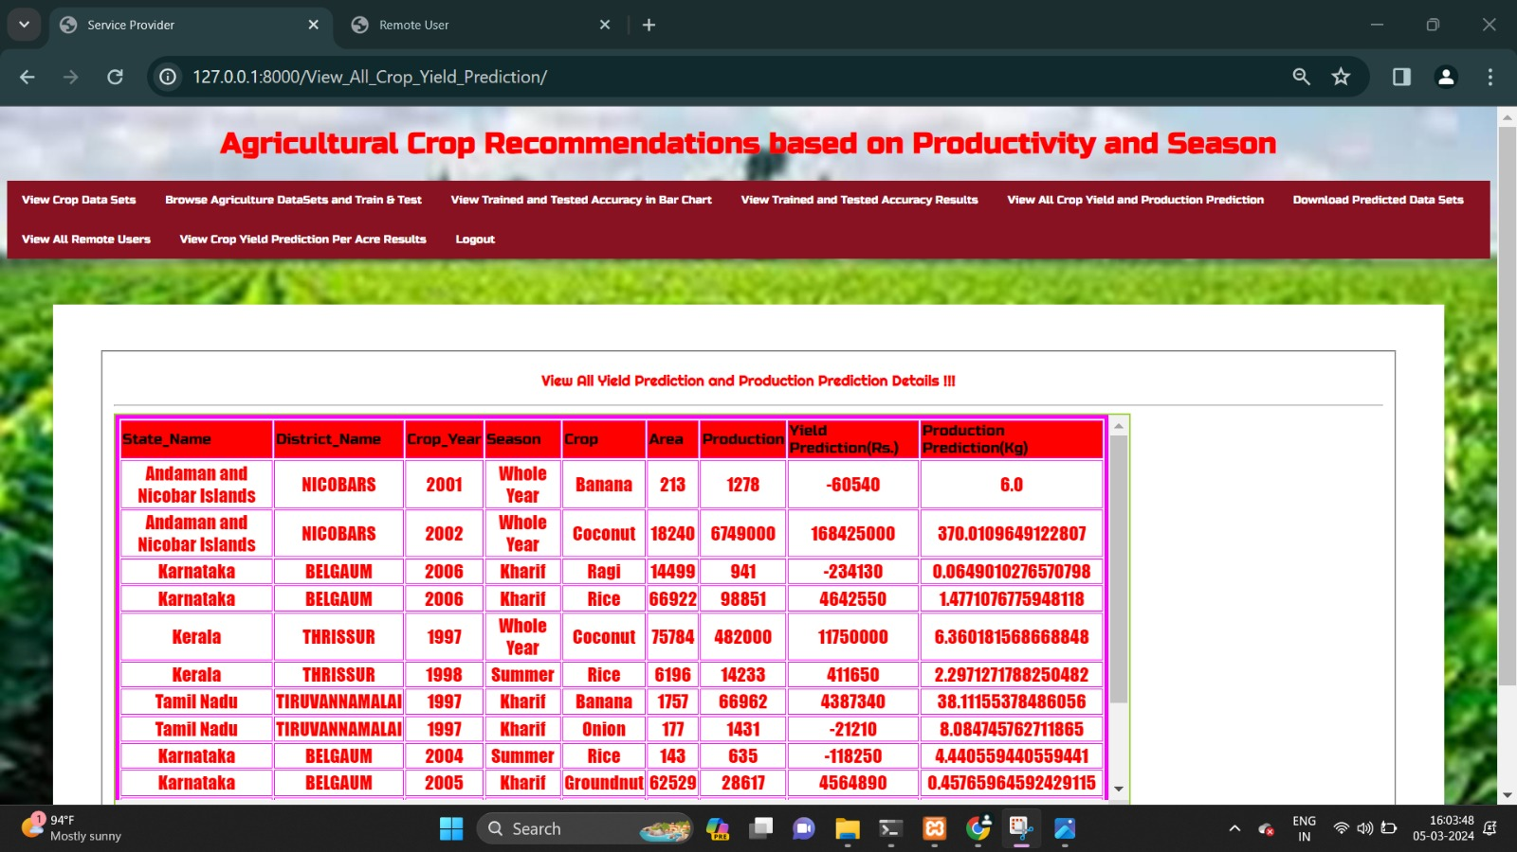
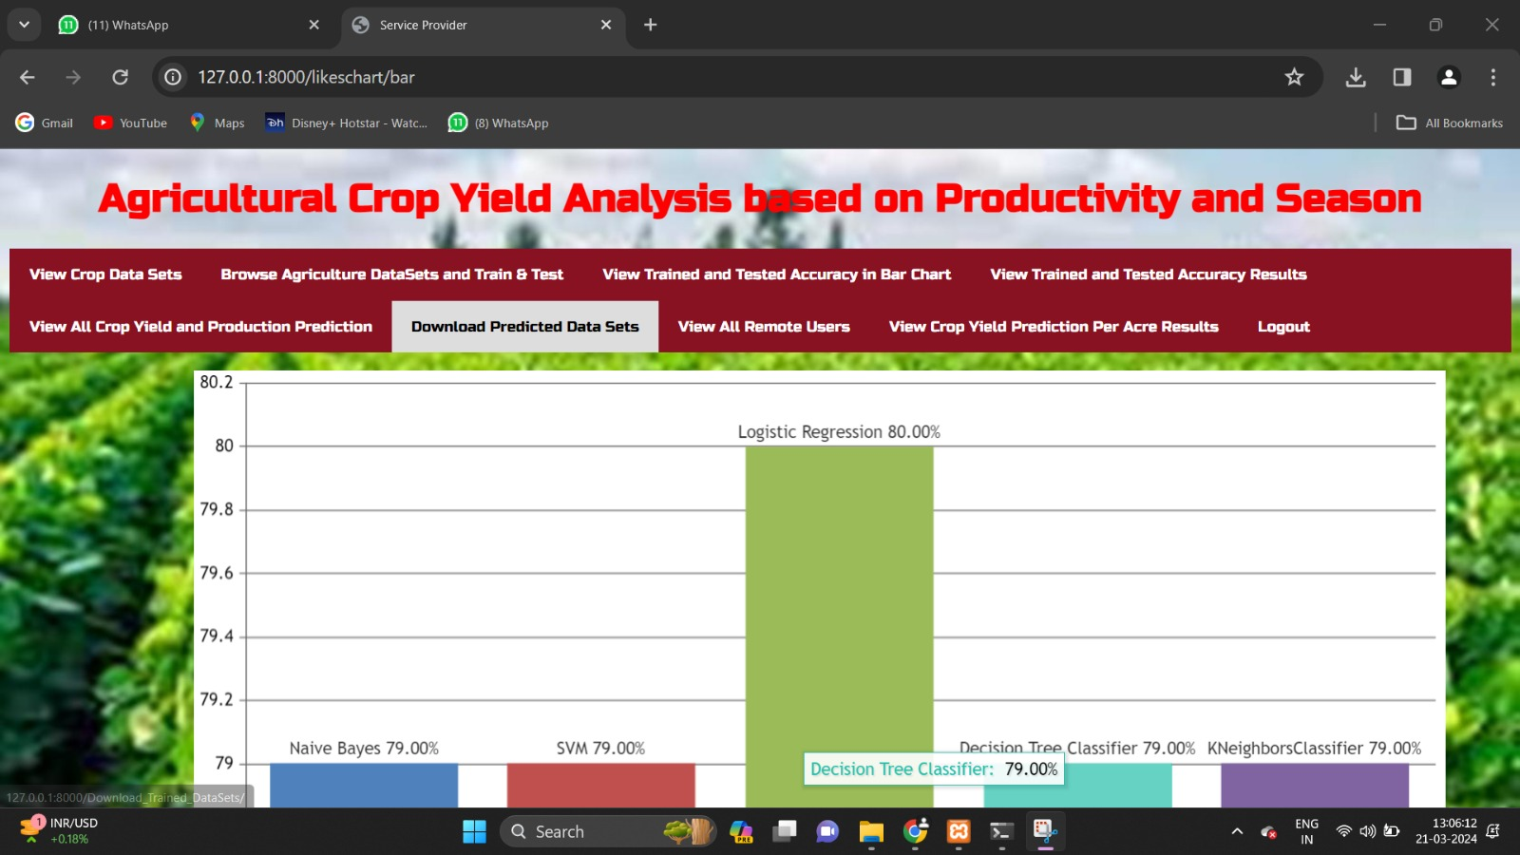
SCREENSHOTS
FINAL PREDICTION PAGE
ACCURACY IN BARCHART

Slide 12
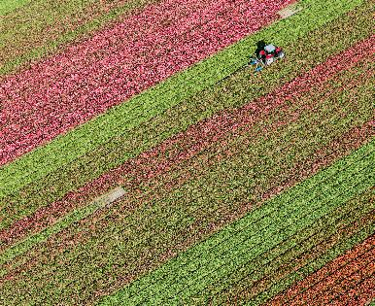
REFERENCES
Manpreet Kaur, Heena Gulati, Harish Kundra, “Data Mining in Agriculture on Crop Price Prediction: Techniques and Applications”, International Journal of Computer Applications, Volume 99– No.12, August 2014.
J. Meng, “Research on the cost of agricultural products circulation and its control under the new normal economic development,” Commercial Times, no. 23, pp. 145147, 2016.
A. Kaloxylos et al., “Farm management systems and the future Internet era,” Comput. Electron. Agricult., vol. 89, pp. 130– 144, Nov. 2012
Y. Wang, "A neural network adaptive control based on rapid learning method and its application," Advances In Modeling and Analysis, Vol. 46(3), pp. 27-34,1994

Slide 13

THANK YOU

